Slide 1
Sustainability Strategies for Flexible Pavements
Hasan Ozer, PhD
Research Assistant Professor
University of Illinois at Urbana-Champaign

Slide 2
Outline
Sustainability: Where did it all start?
Sustainability and Pavements
Life-Cycle Assessment (LCA) Approach
Sustainability Strategies
  What are these?
  How have they been evaluated?
  Next steps?

Slide 3

US DOT is Committed to
Advancing Sustainability
DOT will incorporate sustainability principles into our policies, operations, investments and research through innovative initiatives and actions such as:
  Infrastructure investments and other grant programs,
  Innovative financial tools and credit programs,
  Rule- and policy- making,
  Research, technology development and application,
  Public information, and
  Enforcement and monitoring.
Policy Statement
Signed Secretary Anthony R. Foxx, June 2014
Notes:
Where is the all sustainability discussions coming from? And we keep talking about this in conferences like this and elsewhere.

Slide 4
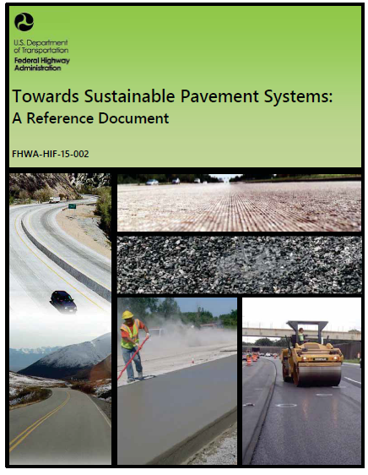
Sustainability Programs and Efforts
FHWA Sustainable Pavements Program
  First phase 2010-2015
  Second phase covering 2015-2020
Webinars
Tech Briefs
Technical Working Group (TWG) Meetings
https://www.fhwa.dot.gov/pavement/sustainability/
Notes:
Implications of such policy changes or directions at federal level trickles down. Here is FHWA programs..

Slide 5
Sustainable Pavements
“Sustainable” in the context of pavements refers to system characteristics that encompasses a pavement’s ability to:
  Achieve the engineering goals for which they are constructed
  Use resources wisely (money + natural)
  Preserve and restore surrounding ecosystems
  Meet basic human needs such as health, safety, employment, and comfort
Notes:
This group agreed on a definition of SP:
While doing all of these, pavements or roadways perform the function they are built for…

Slide 6

Sustainability Metrics and Tools
Performance assessment
  Evaluate performance vs. intended function
  Metrics: distress, thickness, material attributes
Life-cycle cost analysis (LCCA)
  Total user and agency costs over its life-cycle
Life-cycle assessment (LCA)
  Environmental burden of a pavement from cradle to grave
  Environmental burden of producing asphalt mixture
Rating systems
  A list of sustainability best practices with a common metric
Notes:
Measurement of sustainability can be considered as a trade off game between performance, economy and environment. The objective is to get more with less resources. These tools allow us evaluate gains or tradeoffs for every decision we make.

Slide 7
What is LCA?
A method for characterizing and quantifying environmental sustainability of a product or service
Applies a “cradle-to-grave” perspective when analyzing products or systems
LCA methodology follows general purpose ISO 14000 series of standards for all products and services
First use of LCA is a study sponsored by the Coca Cola Company in 1969
  Business decision between reusable or disposable
Notes:
Historical anecdote:

Slide 8
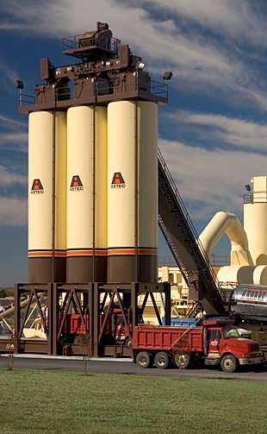
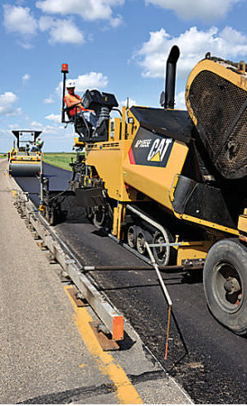
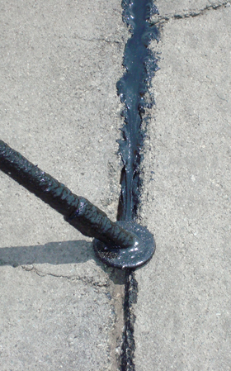

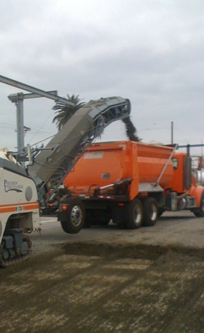
Pavement LCA
Accounting for inputs and outputs throughout pavement life-cycle
Fuel
Electricity
Resources
Materials
Construction
Maintenance
Use
End-of-Life
Pavement deterioration
Rolling resistance
Albedo
Lighting
Transport
Landfill
Recycling
Raw materials
Transport
Mix Production
Transport
Equipment
Placement
Traffic Delay
Repairs
Rehabilitation
Emissions to air
Emissions to water
Emissions to soil

Slide 9
What Can I Use LCA For?
Accounting
  Provide numbers for reporting requirements
  Example: What GHG emissions are attributable to DOT infrastructure projects this year?
Decision support
  Provide information that can influence a decision
  Example: Which pavement alternative uses the least energy? Which mix design has least impact while providing same function in the design?
Process improvement
  Provide feedback to improve a process
  Example: How can we reduce the GHG footprint of an asphalt mix? Transportation, plant energy use, or somewhere else???

Slide 10
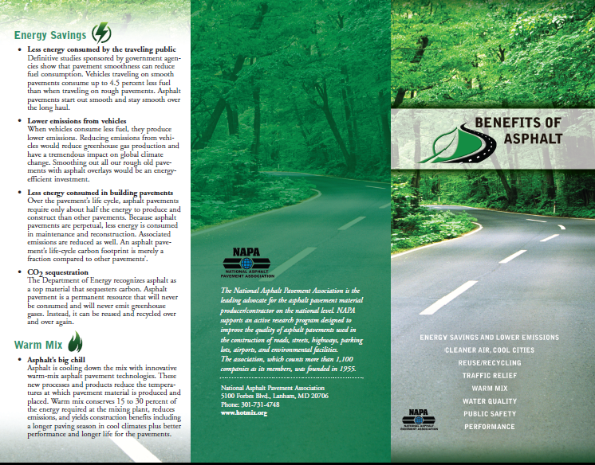
Marketing Claims
NAPA promotes asphalt pavements as:
Less energy in building asphalt pavements
Less energy spent by travelling public
More environmental friendly
Leading recycler to make more sustainable pavements
…
LCA can be used to substantiate such claims (fact checking!)
Notes:
Would not it be nice if we have a tool to do fact checking?

Slide 11
LCA in Decision Making
Paper or plastic bags?
Refillable or disposable?
Electric vs. fuel driven cars
Biomass vs. petroleum products?
Cars vs. transit buses?
How about pavements?
  Design and type selection
  Maintenance and rehabilitation schedule (when to do and what to do to optimize impact)
  Material selection
  …

Slide 12
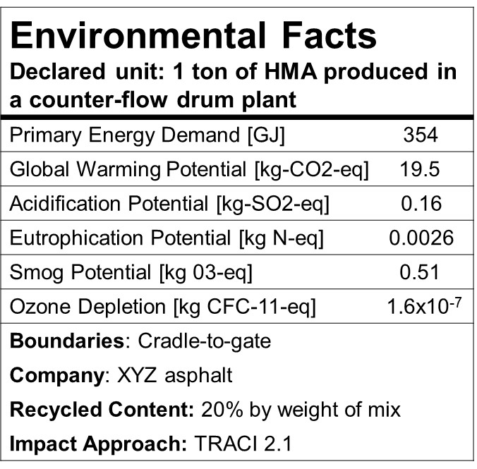
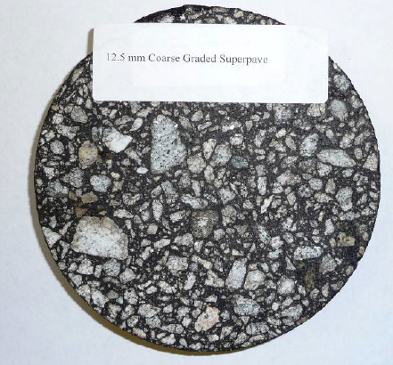
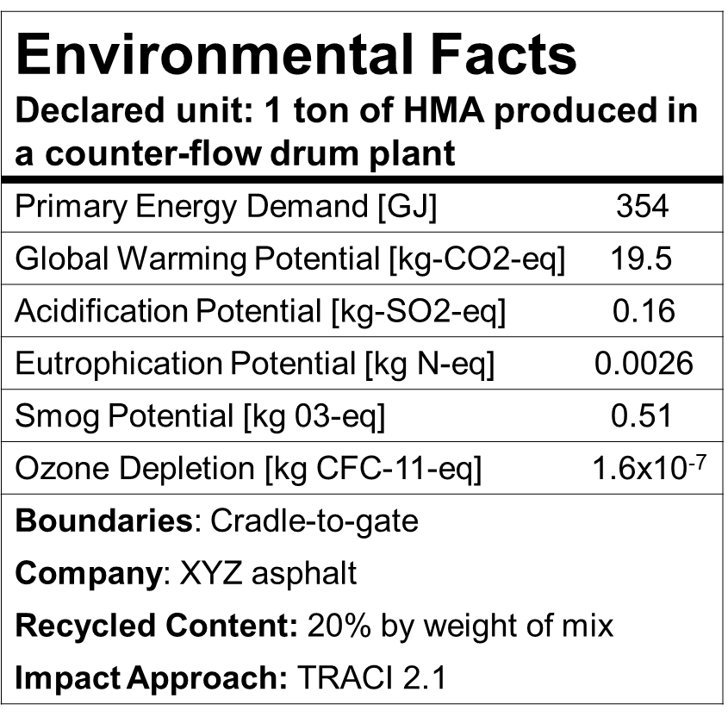
Future of LCAs
Environmental Product Declarations (EPDs) are underway for asphalt and concrete paving materials
Notes:
Where does the industry go?

Slide 13





Illinois Tollway LCA Tool
The Pavement LCA is one of five LCA modules in the Tollway’s Roadway/ Roadside LCA Toolkit
Roadway/
Roadside LCA
Pavement LCA
Drainage LCA
Structures LCA
Lighting LCA
Landscape LCA
Notes:
Current development not so far away from here in Champaing

Slide 14
Strategies for Improving Sustainability
Increase material performance and time between future maintenance and rehabilitation treatments
  Mix design and material selection
  Construction quality
Reduce % of virgin asphalt binder & aggregate, polymer
  Use more RAP, recycled tire rubber, consider RAS
  Only use additional additives where performance increase warrants additional environmental impact
Reduce materials transportation
  Use locally available but lower quality aggregates
  Use in-place recycling
4. Improve efficiency of plant operations
  !! Always check pavement performance to make sure it is not compromised !!
Notes:
What is in our toolbox?

Slide 15
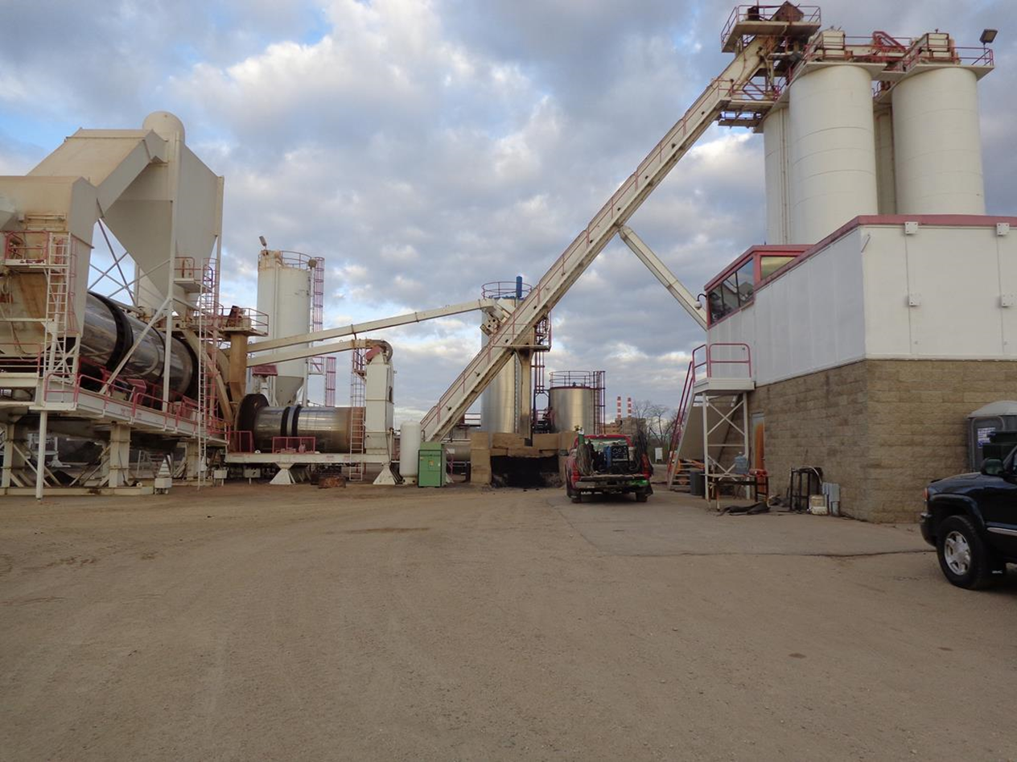
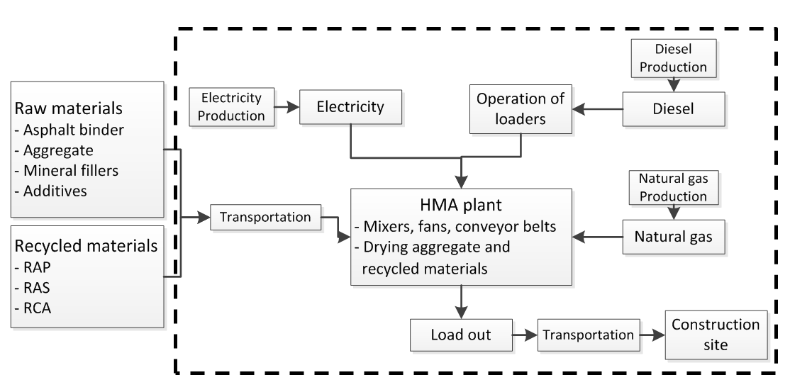
Where Does the Energy Go?
First, we define a system boundary to calculate all inputs and outputs
Yang, R., Kang, S., Ozer, H. and Al-Qadi, I.L., 2015. Environmental and economic analyses of recycled asphalt concrete mixtures based on material production and potential performance. Resources, Conservation and Recycling, 104, pp.141-151.

Slide 16
HMA Primary Energy (as fuel) Breakdown
Virgin HMA Surface Mix
Notes:
Example breakdown from a Tollway pay item.

Slide 17
HMA Primary Energy (as fuel) Breakdown
17% Recycled HMA Surface Mix
Notes:
Example breakdown from a Tollway pay item.

Slide 18
Different Types of Mixes
Energy Consumption from Producing and Mixing
Yang et al. (2015). Quantifying Sustainable Strategies for the Construction of Highway Pavements, TRB
Notes:
Emphasizes transportation variation and significance. From TRB 2016 paper.

Slide 19
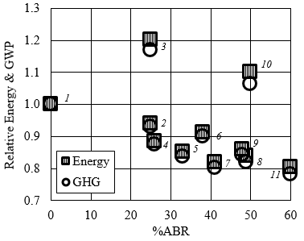
RAP and Environment
Clear reduction in energy and GWP when using recycled materials for replacing virgin binder with recycled binder
SMAs have generally higher energy and GWP
SMA Mixes
HMA/WMA Mixes
Common mixtures used in Illinois having various combinations of RAP and RAS that result in different asphalt binder replacement (ABR) levels

Slide 20
Virgin vs. RAP/RAS
The following questions need to be answered:
  Can equivalent or better performance achieved?
  What is the transportation distance?
  Does RAP undermine future recyclability?
  Can target volumetrics be achieved in the plant and field?
  Are there any specifications limiting its use?
LCA provides a systematic platform to make a comparative assessment and answer such questions
Notes:
Therefore the answer to this question: It depends on the context of the project and performance goals

Slide 21
In-Place Recycling
Three commonly used techniques are:
  Hot in-place recycling (HIR)
  Cold in-place recycling (CIR)
  Full depth reclamation (FDR)

Slide 22
State & Contractor Perspectives
Environmental Benefits from using in-place recycling
Overall perception is positive
Use is limited to less than 50 lane-miles a year
Stroup-Gardiner (2011). Recycling and Reclamation of Asphalt Pavements Using In-Place Methods.
Notes:
ADD USAGE STATS

Slide 23
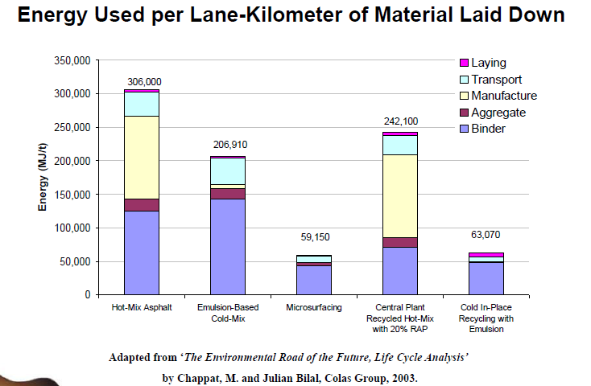
Sustainability Impacts
Literature is full of studies reporting significant reduction in energy and emissions with in-place techniques

Slide 24
Sustainability Impacts
Very context sensitive
  CIR treatment life reported in the literature: 6 to 15 years (Peshkin et al. 2011)
Avoided hauling and its impacts
Traffic closures and resulting delays
Surface treatment type
Availability of specialized contractor and mobilization distances
Additive selection (emulsion vs. cement)
Depth of recycling
…
Notes:
Once again the real answer to this question is again it depends….
There is a reason for this. You may reverse your findings if you get 6 or 15 years.
These are just some of the things that we need know and calculate accurately
We may have some expectation but cannot say anything until we analyze project by project.

Slide 25
Ongoing FHWA Study
FHWA study is underway to develop a “Life-Cycle Methodology and Tool for Energy Use by In-Place Pavement Recycle Techniques”
University of Illinois, UCDavis, and Rutgers are partnering
The life-cycle tool will make comparative assessment considering:
  Regional characteristics
  Life-cycle methodology
  Realistic contractor data collected across the US
  Agency surveys
  User friendly tool that can be used by agencies and contractors

Slide 26
Concluding Remarks
Sustainability is a system characteristics and goals cannot be achieved alone by one contractor, one agency, or one industry
There are tools and sufficient number of strategies for asphalt pavements to make a difference
Sustainability goals can provide opportunities to both agencies and industry
Sustainability can help contractors and producers to enhance their product portfolio (WMA example)

